Slide 1
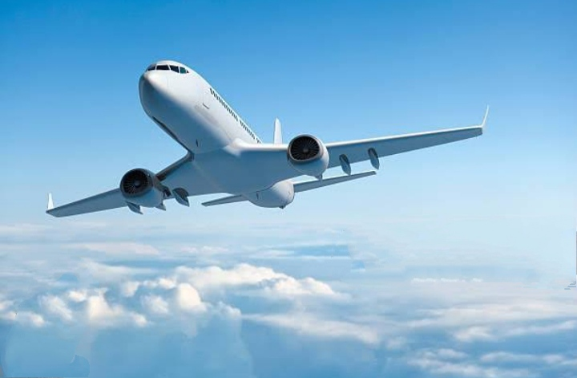
Flight delay prediction for Aviation industry using Machine learning

Slide 2
Team members: V. Manjula K .Saranya S .Keerthana V. Thenmozhi INTRODUCTION: As people increasingly choose to travel by air, the amount of flights that fail to take off on time also increases. Air transportation delay indicates the lack of efficiency of the aviation system. Nowadays, the demand for airline transportation increasing significantly.
Welcome to our project

Slide 3
Problem statements:
The impact of flight delay can be a risk and this risk represents
financial losses
The dissatisfaction of passengers
Time losses, loss of reputation
Bad business relations
Inclement of weather
SOLUTION:
A Flight delay prediction acsses quickly
Purpose:
Therefore, predicting flight delays can improve airline operations and passenger satisfaction, which will result in a positive impact on the economy.

Slide 4
PROJECT DEVELOPMENT
Define problem / problem understanding
Data collection & preparation
Exploratory Data Analysis
Model Building
Performance Testing &
Hyperparameter Tuning
Model Deployment
Project Demonstration & Documentation

Slide 5
Data source:
We have gathered data from kaggle.com and
Download to the dataset from flightdata.csv
Data had around 5 million rows and 25 columns
Importing the libraries.
Data preprocessing:
Handling missing values
Handling categorical data

Slide 6
Data understanding: Available varibles Relationships
Objective:
Identify and analyze the factors that cause flight
Delay
Predict flights that will get delayed

Slide 7
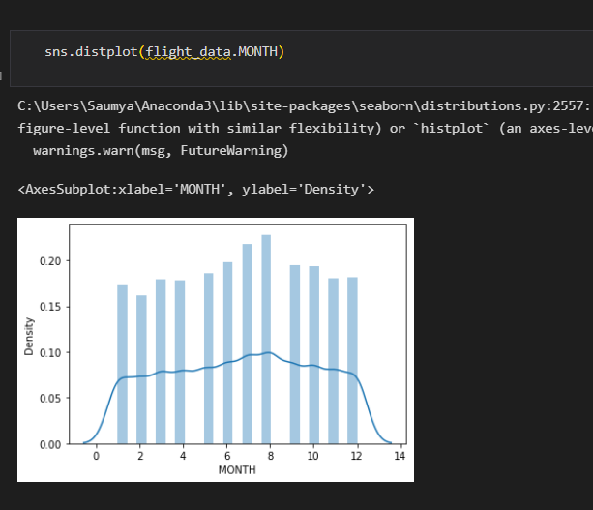
Exploratory data analysis:
Univariate analysis:
univariate analysis is understanding the data with a single feature.
Here we have displayed two different graphs such as distplot and countplot.

Slide 8
Implementations:
Training the model:
Now our data is cleaned and it’s time to build the model.
We can train our data on different algorithms. For this
project we are applying four classification algorithms.
The best model is saved based on its performance.
Building and training an Artificial Neural Network (ANN)
using the Keras library with TensorFlow as the backend.
Testing the Model:
In ANN we first have to save the model to the test the inputs.
This code defines a function named "predict_exit" which
takes in a sample_value as an input.
The function then converts the input sample_value
from a list to numpy array.
Finally, the function returns the prediction of the classifier
on the scaled sample_value.

Slide 9
Aim of the project:
The main goal is to compare the performance of machine learning classification algorithms when predicting flight delays.
Conclusion:
Flight delays are an important subject in the literature due to their economic and environmental impacts.
They may increase costs to customers and operational costs to airlines.
Apart from outcomes directly related to passengers, delay prediction is crucial during the decision-making process for every player in the air transportation system.

Slide 10
Thank you.

Slide 14
Project flow:

